Slide 1







Technology Trends
Aditya Roundhal
20 September 2024

Slide 2



OUTLINE
Executive Summary
Introduction
Methodology
Results
Visualization – Charts
Dashboard
Discussion
Findings & Implications
Conclusion
Appendix

Slide 3

EXECUTIVE SUMMARY
Purpose of the Study: The project analyzes trends in programming languages and database systems for the current year and forecasts changes for the next year. The goal is to understand how these trends impact the tech industry and future job prospects.
Methodology: The analysis was conducted using data on the most popular programming languages and databases. Various data visualization techniques, including bar charts and dashboards, were employed to highlight key insights.
Key Findings: Programming Language Trends: Python and JavaScript are the leading languages, with growth expected in machine learning and web development. Emerging languages like Go and Rust are on the rise. Database Trends: Cloud-based and NoSQL databases are gaining popularity, with companies transitioning away from traditional relational databases for scalability.
Implications: The demand for cloud infrastructure and data science skills is growing rapidly. Companies need to adapt their tech stacks, while professionals should focus on gaining expertise in in-demand languages and tools.
Conclusion:The study highlights the importance of staying updated with evolving technologies. Continuous learning and adaptation are essential for individuals and organizations to remain competitive.

Slide 4

INTRODUCTION
Context: In today’s rapidly evolving tech landscape, staying up-to-date with the latest trends in programming languages and database systems is crucial for both individuals and businesses. As technology progresses, these trends directly impact industry practices, career growth, and organizational decisions.
Purpose of the Project: The project aims to analyze current trends in programming languages and database systems, predict future shifts, and explore their implications for the tech industry. Understanding these trends helps organizations make informed decisions about their tech stacks and allows professionals to focus on the skills that will be most in demand.
Scope of the Analysis: This study focuses on identifying the top 10 programming languages and databases for the current year and forecasting their ranking for the following year. It also examines the potential impact of these trends on the job market and organizational tech adoption.
Objective: To provide actionable insights for both individuals and organizations by identifying key technology trends and offering suggestions on how to adapt to these shifts for long-term success.

Slide 5

METHODOLOGY
Data Collection: Data was collected from reputable sources such as GitHub, Stack Overflow, and industry reports on the most popular programming languages and databases. The dataset includes historical usage statistics and job market trends.
Data Cleaning & Preparation: The raw data was cleaned to remove duplicates, inconsistencies, and irrelevant information. It was then standardized to ensure accuracy in comparing trends across different years.
Tools Used: The analysis was conducted using Python for data manipulation and Google Looker Studio for data visualization. Key libraries such as Pandas and Matplotlib were used for data processing and chart generation. Dashboard: A dynamic dashboard was built in Google Looker Studio to interactively explore the trends in programming languages and databases.
Analysis Techniques:
Trend Analysis: Historical and current data were compared to identify growth or decline in popularity for different technologies.
Forecasting: Predictive models were used to estimate the ranking of programming languages and databases for the next year based on historical patterns.
5. Visualization: Bar charts and other visual aids were used to clearly depict the trends over time, with an emphasis on year-over-year changes and future predictions.

Slide 6
RESULTS
Programming Language Trends (Current Year vs. Next Year):
Current Year: Python and JavaScript are the leading programming languages, with substantial adoption in areas like machine learning, web development, and automation.
Next Year: Forecast indicates continued dominance of Python, with rising interest in newer languages like Rust and Go, which are gaining popularity for their performance and security.
2. Database Trends (Current Year vs. Next Year):
Current Year: Relational databases (e.g., MySQL, PostgreSQL) are still widely used, but NoSQL databases (e.g., MongoDB, Firebase) are growing in popularity, particularly for cloud and real-time applications.
Next Year: The forecast predicts an even greater shift towards NoSQL databases, with increasing adoption of cloud-based solutions.
3. Key Findings
Programming Languages: The dominance of Python and JavaScript reflects the industry’s focus on automation, AI, and web technologies. Emerging languages like Rust and Go are gaining traction in performance-critical fields.
Databases: The shift towards NoSQL and cloud-based databases underscores the need for more scalable and flexible data storage solutions, especially in industries with big data requirements.

Slide 7
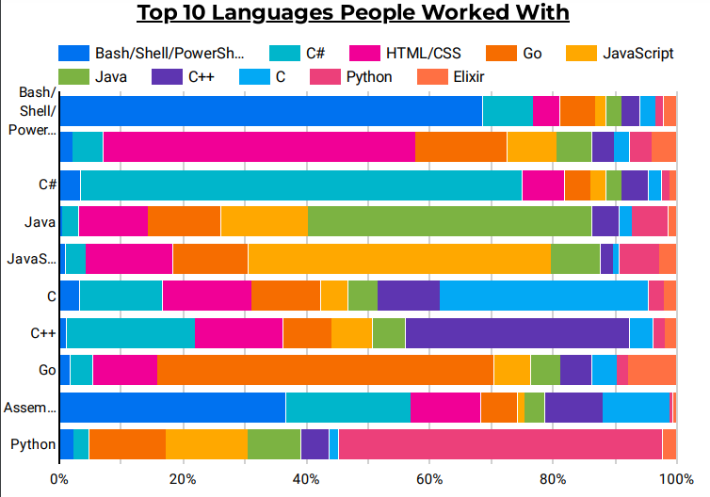
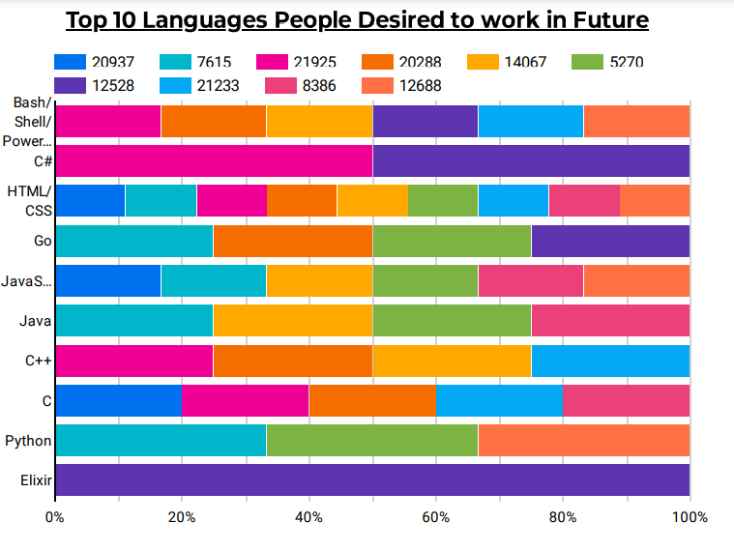
PROGRAMMING LANGUAGE TRENDS
Current Year
Next Year

Slide 8
PROGRAMMING LANGUAGE TRENDS - FINDINGS & IMPLICATIONS
Findings
Identify the top programming languages for the current and next year.
Highlight notable changes (e.g., the rise or fall of specific languages).
Mention any unexpected trends or emerging technologies.
Implications
Suggest how these trends affect job prospects (e.g., increased demand for certain languages).
Discuss how companies might need to adapt their tech stacks.
Highlight the importance of staying updated with the fastest-growing languages.

Slide 9
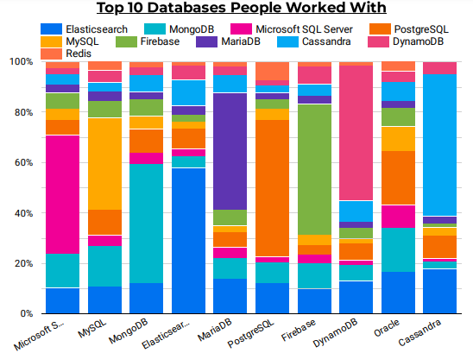
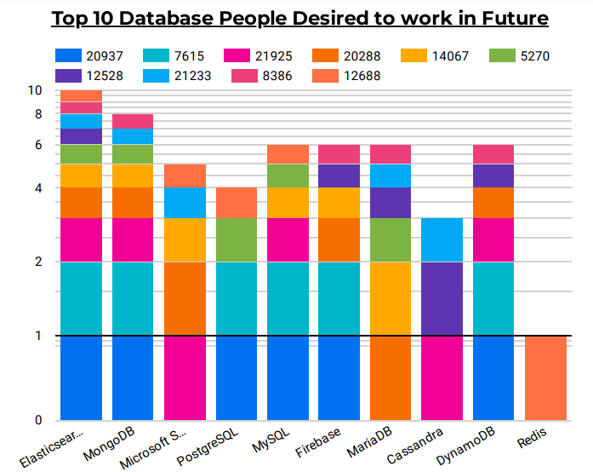
DATABASE TRENDS
Current Year
Next Year

Slide 10
DATABASE TRENDS - FINDINGS & IMPLICATIONS
Findings
Showcase the top database systems in use currently and next year.
Compare relational databases versus NoSQL trends.
Note any shifts towards cloud-based databases or new technologies.
Implications
Explain how businesses can leverage the emerging database trends for scalability.
Discuss the impact on data management strategies.
Suggest how organizations might need to upskill their teams in database management.

Slide 11

DASHBOARD
https://github.com/Adityar294/Data_analysis/tree/main/Capstone%20Project_1

Slide 12
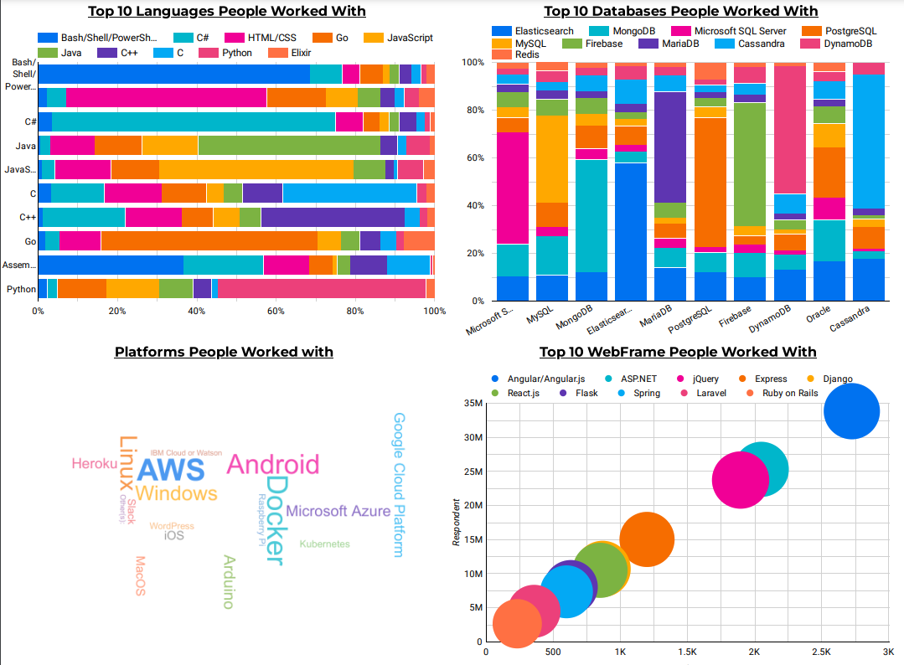
DASHBOARD TAB 1

Slide 13
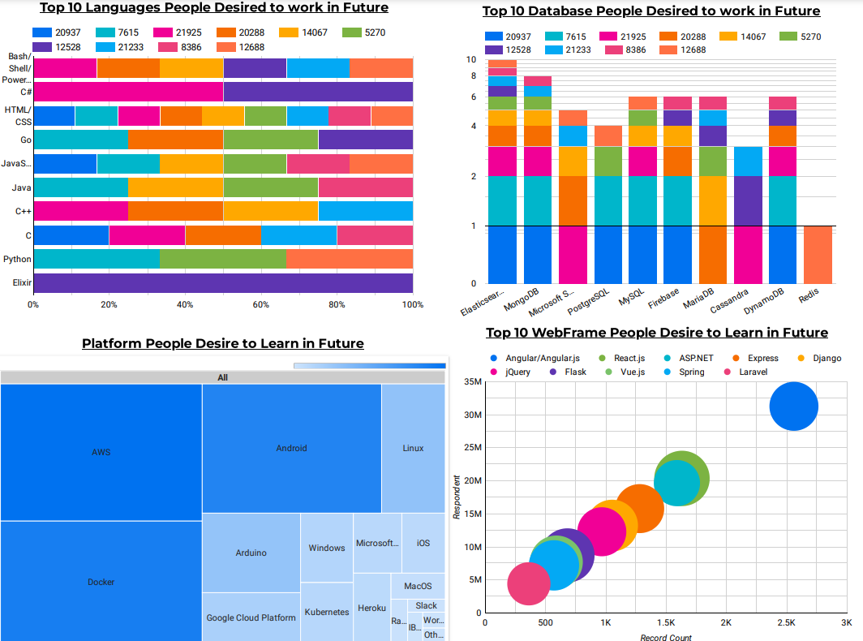
DASHBOARD TAB 2

Slide 14
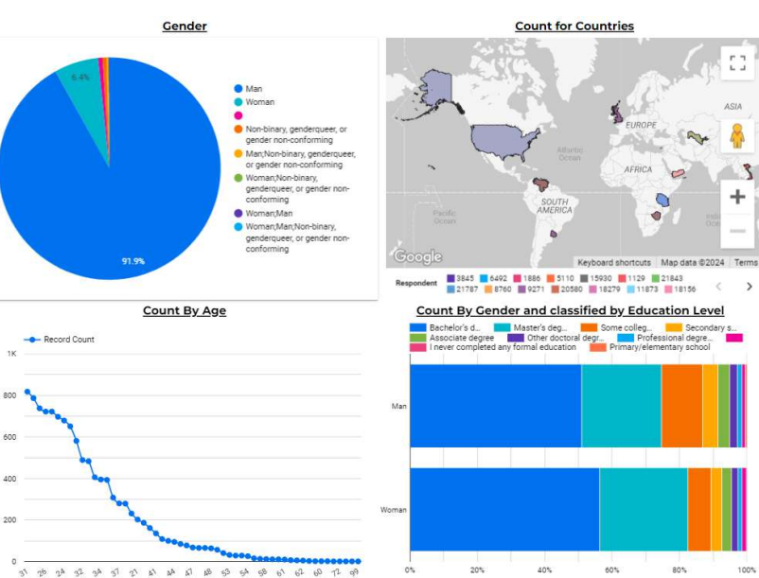
DASHBOARD TAB 3

Slide 15
OVERALL FINDINGS & IMPLICATIONS
Findings
Summarize the overall trends across both programming languages and databases.
Highlight common themes or major disruptions.
Note industry-specific impacts (e.g., fintech, healthcare).
Implications
Suggest how businesses can future-proof their operations based on these trends.
Discuss the need for continuous learning and adapting technology infrastructure.
Predict long-term industry effects based on current and upcoming trends.

Slide 16

CONCLUSION
Key Takeaway 1: Shifts in Programming Language Popularity. The data shows a growing preference for languages such as Python and JavaScript, which continue to dominate across industries due to their versatility and broad application in areas like web development and machine learning. Action: Professionals should focus on gaining proficiency in these languages to stay competitive in the job market.
Key Takeaway 2: Rise of Cloud-Based Databases. Cloud-based databases and NoSQL systems are becoming more popular, highlighting a shift towards scalable, flexible data management solutions that support big data and real-time processing. Action: Businesses should consider transitioning to cloud databases to ensure scalability and better performance for data-driven applications.
Key Takeaway 3: Need for Continuous Learning and Adaptation. With the rapid evolution in technology trends, particularly in programming languages and database systems, both individuals and organizations must invest in continuous learning to remain relevant. Action: Organizations should support professional development initiatives, and individuals should keep up with trends through certifications and hands-on projects.
Future Directions : The trends point towards an increasing demand for skills in emerging technologies like AI, machine learning, and cloud infrastructure, which suggests future analysis should include these fields. Action: Future research should focus on how these evolving technologies will reshape the technology landscape and affect career prospects in the next 5-10 years.

Slide 17
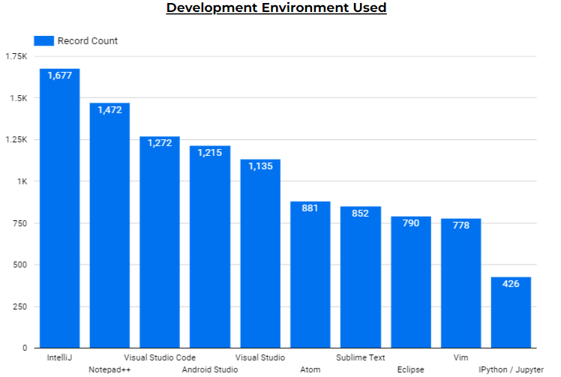

APPENDIX

